Slide 1
Neural Turing Machines
陈彦骐
Graves A, Wayne G, Danihelka I. Neural turing machines[J]. arXiv preprint arXiv:1410.5401, 2014.

Slide 2
Outline
Introduction to Turing Machines
Neural Turing Machines

Slide 3
Definition
A tape divided into cells
A head that can read and write symbols on the tape and move the tape left and right one (and only one) cell at a time.
A state register
A finite table of instructions (finite-state machine, FSM)

Slide 4
Example 1 (Alan Turing 1937)
Initial tape: Nothing (All cells are blank)
State table:
Initial State: b, any position (tape)
Result: 0 <blank> 1 <blank> 0 ……
Configuration |  | Behavior
Current state | Scanned tape symbol | Tape operations | Final state
b | <blank> | P0(Print symbol ‘0’), R(Move right) | c
c | <blank> | R | e
e | <blank> | P1, R | f
f | <blank> | R | b

Slide 5
Example 2 (Copy task)
Initial tape: Series of 1s, 0 for other position
Result: Double this series by writing a 0 between them
“111”→“1110111”
Initial state: s₁, the beginning of series (the left most ‘1’)
State table:

Slide 6
Example 2
Configuration |  | Behavior
Current state | Scanned tape symbol | Tape operations | Final state
s₁ | 0 | - | H
s₁ | 1 | R | s₂
s₂ | 0 | R | s₃
s₂ | 1 | P1, R | s₂
s₃ | 0 | P1, L | s₄
s₃ | 1 | P1, R | s₃
s₄ | 0 | L | s₅
s₄ | 1 | P1, L | s₄
s₅ | 0 | P1, R | s₁
s₅ | 1 | P1, L | s₅
H | - | - | -

Slide 7
Core issue
Design of the state table: Programming
Encode

Slide 8
Outline
Introduction to Turing Machines
Neural Turing Machines

Slide 9
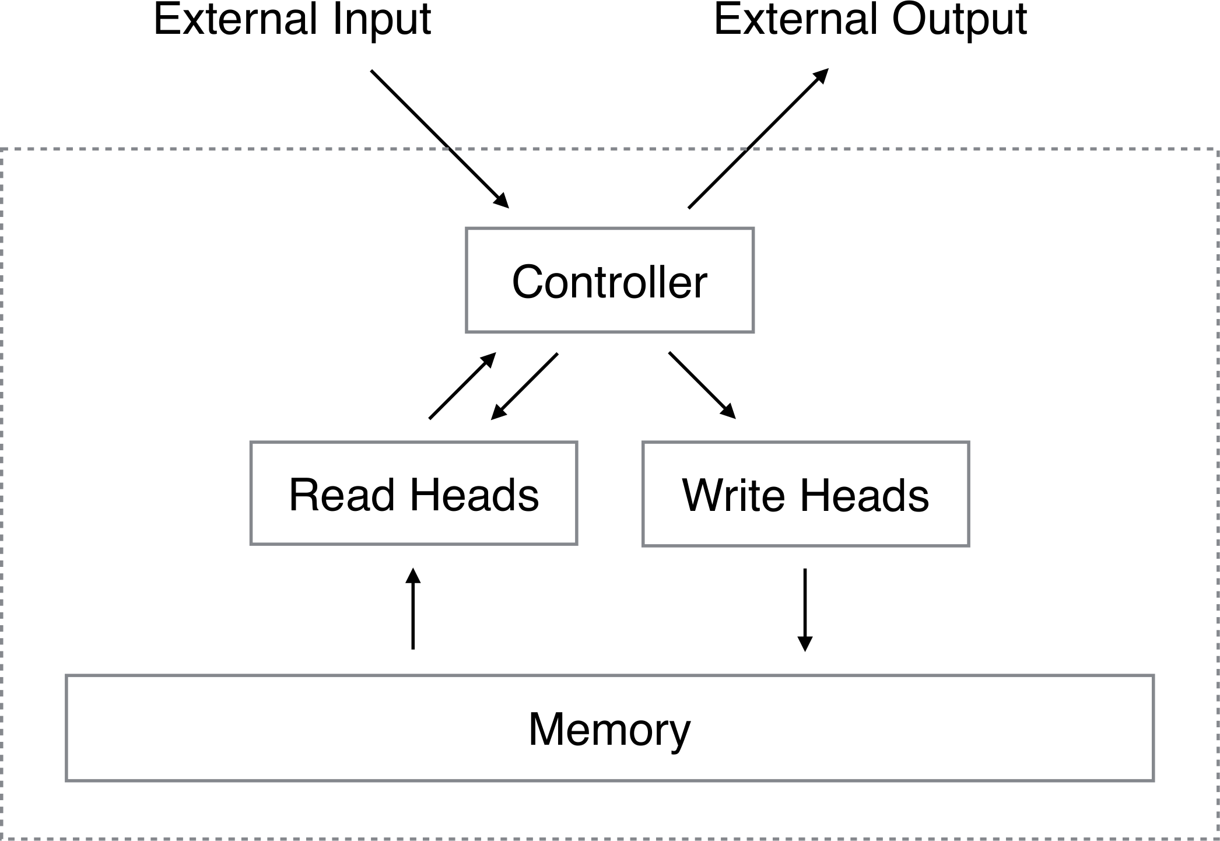
Architecture
von Neumann architecture
Distinguish input, output, memory
Random access memory
Controller: implicit state table
Larger word size

Slide 10
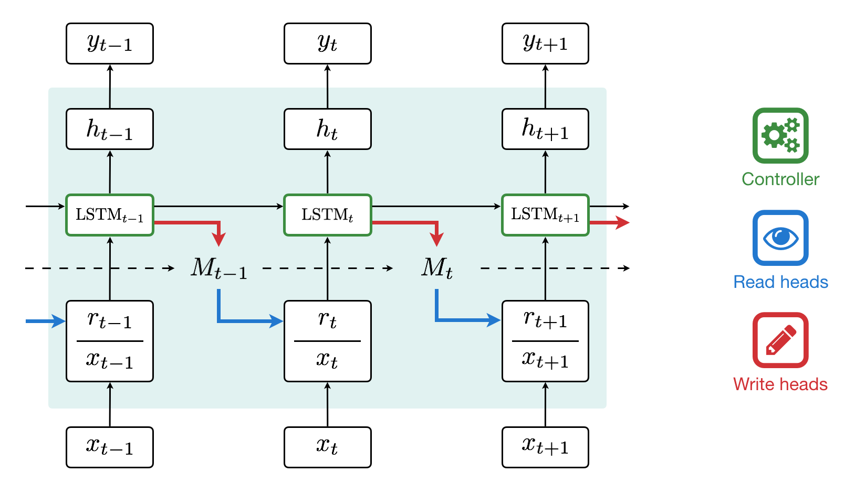
Controller
RNN cell, usually LSTM
Controller Input
Read content + Input
https://medium.com/snips-ai/ntm-lasagne-a-library-for-neural-turing-machines-in-lasagne-2cdce6837315

Slide 11
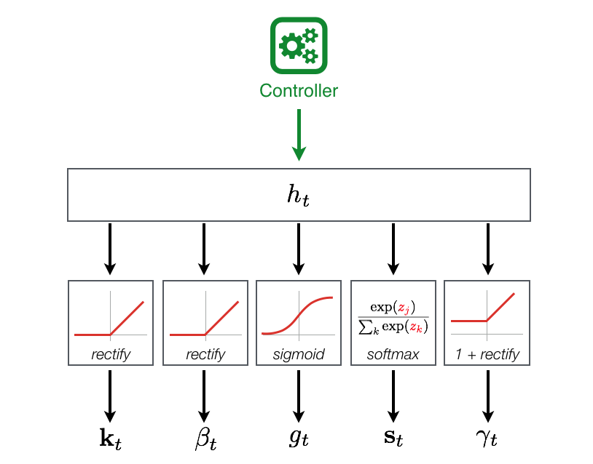
Controller
Controller Output
Parameters for read or write

Slide 12

Addressing Scheme
Read/Write weight
Weighted sum of $N×M$ memory
Read
Weighted sum
$r_{t}⟵\sum_{i}{w_{t}\left(i\right)M_{t}(i)}$
Write
Erase
${\tilde{M}}_{t}\left(i\right)⟵M_{t−1}\left(i\right)\left[1−w_{t}\left(i\right)\right]e_{t}$
Add (write)
$M_{t}\left(i\right)⟵{\tilde{M}}_{t}\left(i\right)+w_{t}\left(i\right)a_{t}$

Slide 13
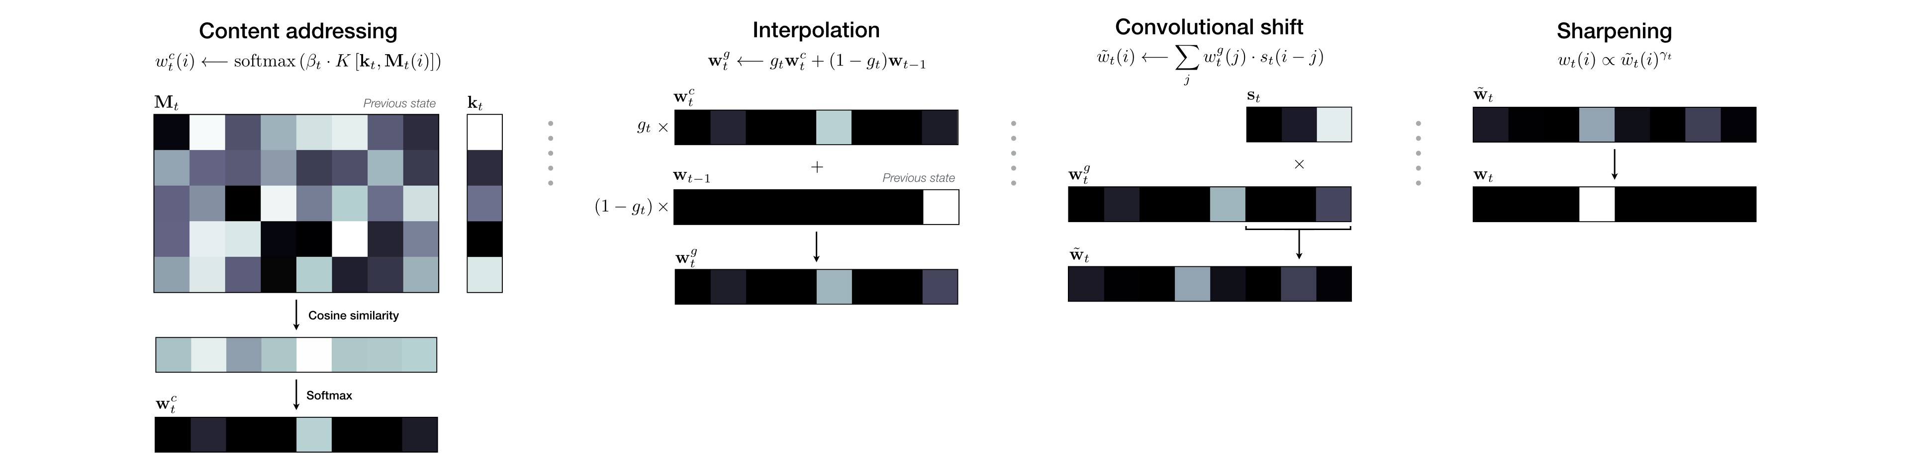
Weight generation

Slide 14
Weight generation
https://distill.pub/2016/augmented-rnns/

Slide 15
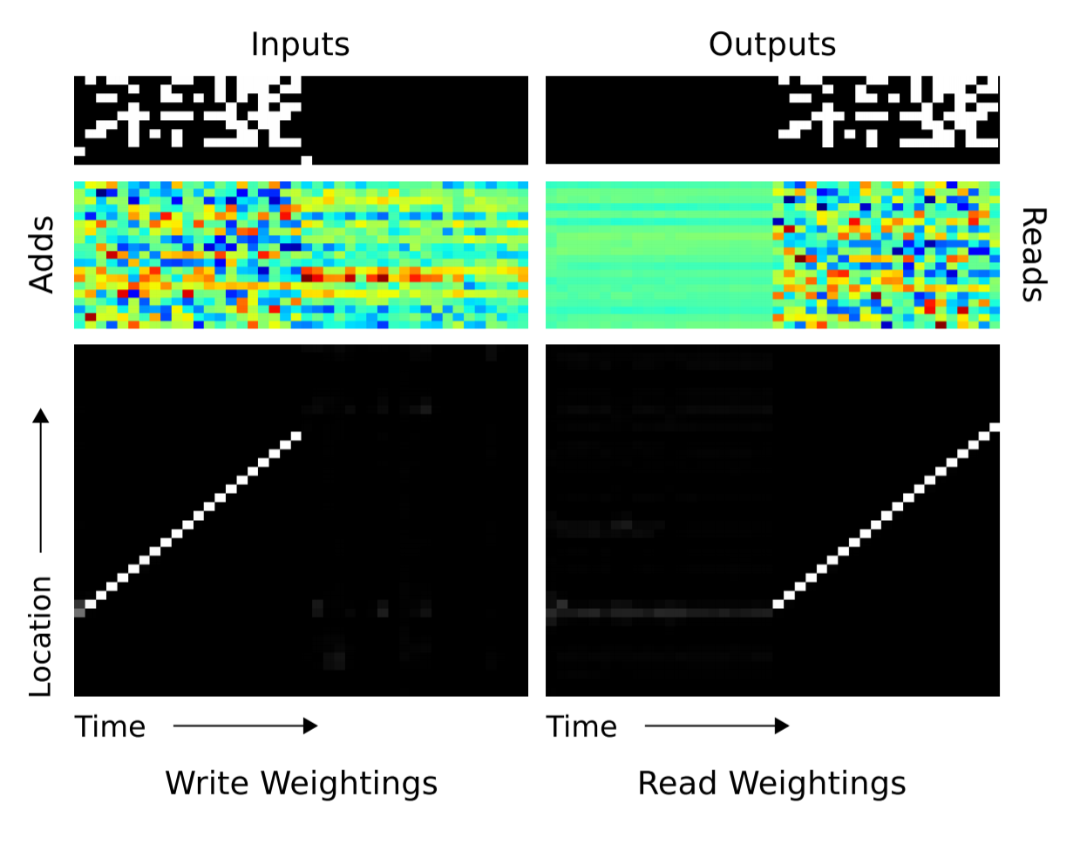
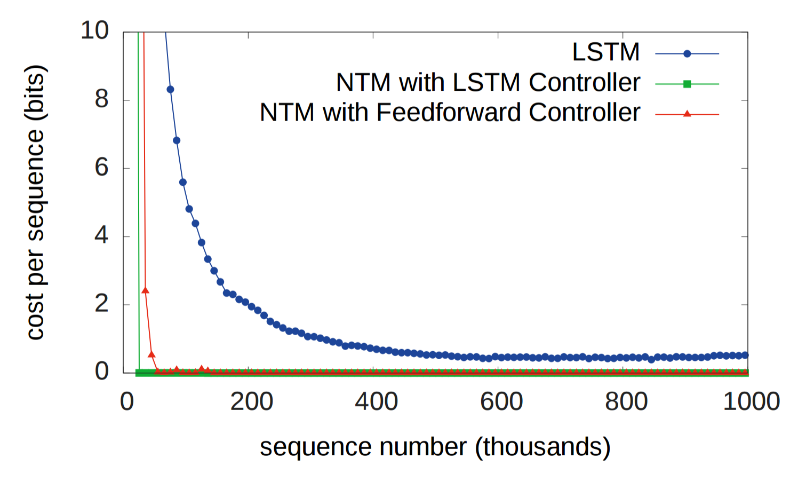
Experiments (Copy)

Slide 16
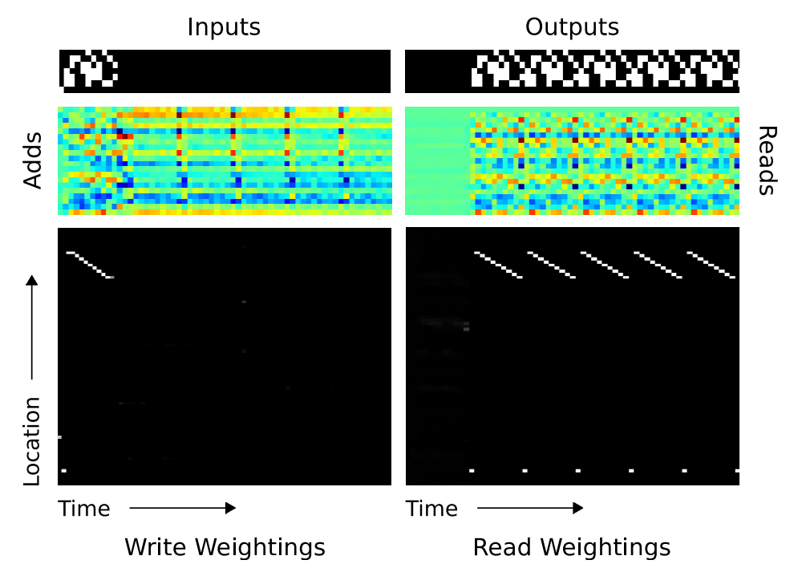
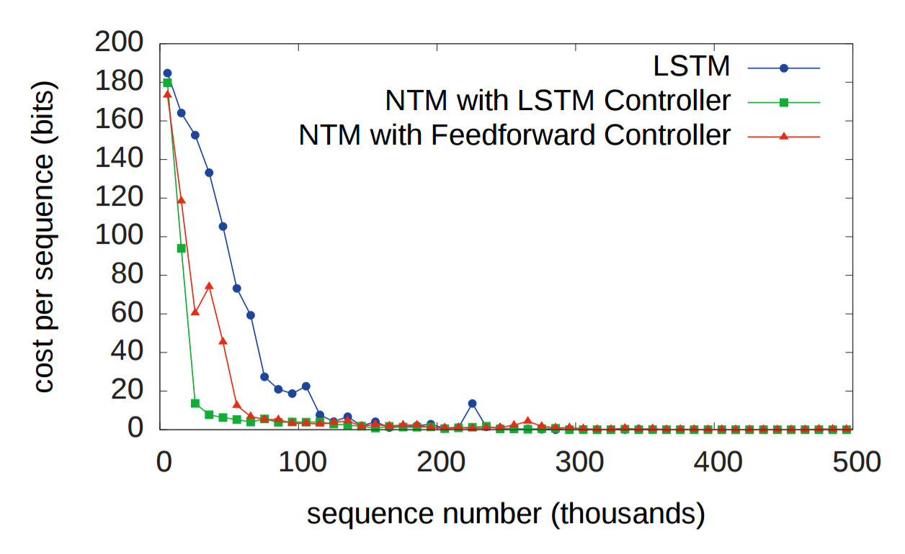
Experiments (Repeat Copy)

